Slide 1
REPORTLAB COMPLETE TUTORIAL
Create Custom Report Template:Part 60
TOTAL TECHNOLOGY

Slide 2

Base Template
TOTAL TECHNOLOGY

Slide 3
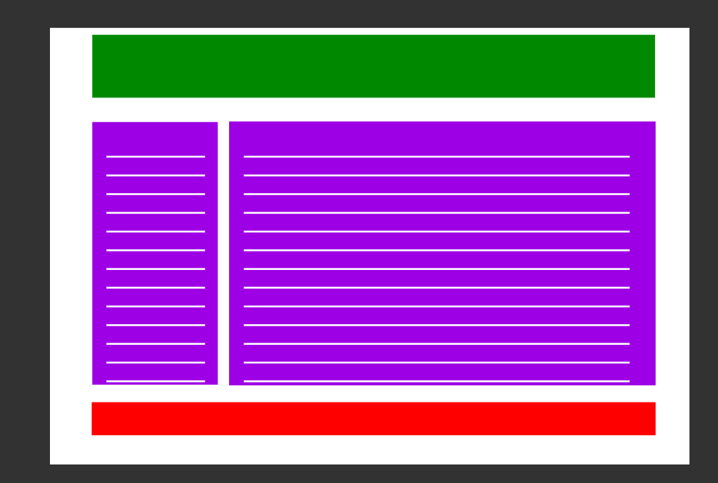
Final Template
TOTAL TECHNOLOGY

